Slide 1
Joins Part 5 and Loose Ends
Select ‘Top’ instead of ‘*’
Recap of Joins: Left, Right, Full, Self, Cross
Recap of Views: Join, Hide Column/Row
Query Execution Plan and performance
Other operators to take a look at

Slide 2
Select Top (5, 10, 20)
If you have 1 million rows, Select * might be a bad idea
select top 5 * from nurse
--compare
select * from nurse

Slide 3
Joins: Types and why we use them
Inner
Operation: exclusive, most common
Purpose: Include only matching rows from tables on both sides of join command.
Left / Right “outer”
Operation: inclusive matching
Purpose: Include all from inclusive side (left or right), and only the matching rows from other side.
Full
Includes ALL rows from both sides. (why bother? Just do a select *)
Because it is still a matching, not just a two column lists.
Cross
Operation: matches every record from one side to every record from the other side.
Purpose: Called a “Cartesian” join. Often to generate test data. Creates a result of all the permutations between the selected columns.
Self
Operation: For unary relations. Matches PK to Recursive FK in same table.
Purpose: We see this in manager/employee relations.
Inner
Left
Right

Slide 4
Left, Right, Full
Checking confidence of our Inner Join query.
Tracking down rows without corresponding matches.

Slide 5
--Show me all beds assigned to patients
select b.bedid as 'Beds', p.patientid as 'Patients'
from bed b
join patient p
on b.bedid = p.bedid
--Show me all beds assigned and open
select b.bedid as 'Beds', p.patientid as 'Patients'
from bed b
left join patient p
on b.bedid = p.bedid
--Better without 'nulls'
--have to convert data type from int to char and replace ‘null’ with
select b.bedid as 'Beds', isnull(convert(char(12), p.patientid), 'not assigned') as 'Patient'
from bed b
left join patient p
on b.bedid = p.bedid
--Show me any beds not currently assigned
select b.bedid as 'Beds', isnull(convert(char(12), p.patientid), 'not assigned') as 'Status'
from bed b
left join patient p
on b.bedid = p.bedid
where patientid is null
--Or maybe we should title it as 'open' “Show me a list of all open beds”
select b.bedid as 'Beds', isnull(convert(char(12), p.patientid), 'open') as 'Status'
from bed b
left join patient p
on b.bedid = p.bedid
where patientid is null
Show me all Beds and Patients

Slide 6
--Show me all patients and their bed assignment status
--Right join
select b.bedid as 'Beds', p.patientid as 'Patients'
from bed b
right join patient p
on b.bedid = p.bedid
--Better without 'Nulls'
--Notice I flipped the order of columns, but not the join
select p.patientid as 'Patient', isnull(convert(char(12), b.bedid), 'not assigned') as 'Bed'
from bed b
Right join patient p
on b.bedid = p.bedid
--Show me all patients not assigned a bed
select p.patientid as 'Patient', isnull(convert(char(12), b.bedid), 'not assigned') as 'Bed'
from bed b
Right join patient p
on b.bedid = p.bedid
where b.bedid is null
Show me all Patients and Beds

Slide 7
Show me all beds and all patients
With and without matches
--Full Join
--Show me beds without patients and patients without beds
--In this case I want nulls because its easier to quickly scan
select b.bedid as 'Beds', p.patientid as 'Patients'
from bed b
Full join patient p
on b.bedid = p.bedid

Slide 8
Self Join
For Unary relations with recursive FKs.
Managers, Supervisors, Mentors.
select e.Lastname as 'Employee', e.empno as 'Employee No', e.mgrno as 'Manager No', m.lastname as 'Manager Name'
from employee e
left join employee m
on m.empno = e.mgrno
order by e.mgrno
--compare
select Lastname as 'Employee', empno as 'Employee No', mgrno as 'Manager'
from employee
--where mgrno is not null
order by mgrno

Slide 9
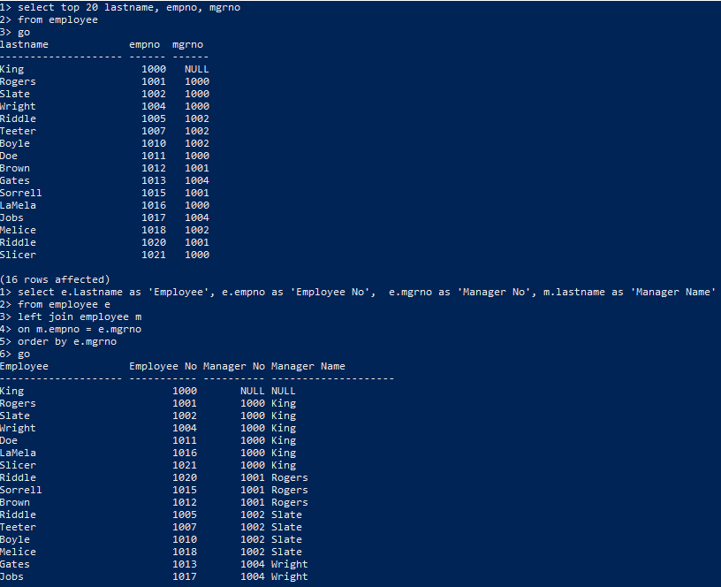
You can run it real quick in CMD to test
Employee by name, number and manager number
Employee by name, number and manager number with
manager’s name

Slide 10
Views and how we can use them
Row View (single user access to own record)
Column View (hiding information the user should not see)
Join View (pre-joining, “nested query.”)
create view MaryBrown_vw
as
select * from Employee
where empno = '1012'
CREATE VIEW Employee_vw
AS
SELECT EmpNo, FirstName, LastName, JobTitle, HireDate, MgrNo, DeptNo
FROM Employee
create view customerEmployee_vw
as
select E.lastname as 'Account Rep', C.companyname
from employee as e
join customer as c
on e.empno = c. AcctRepNo

Slide 11
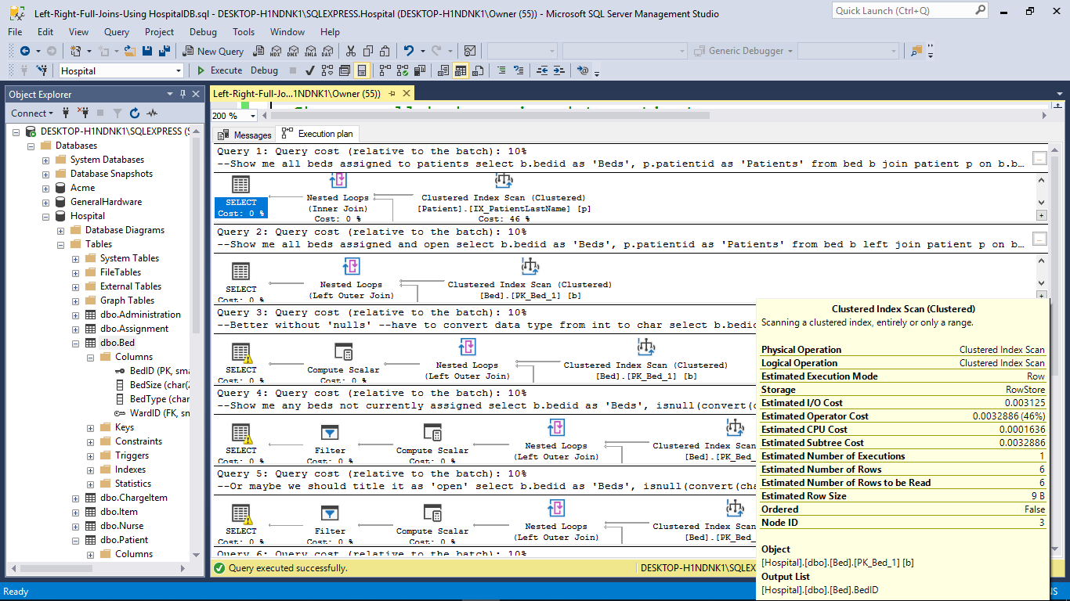
Query Execution Plan and Statistics

Slide 12
SPROC Parameters: Provides additional search flexibility
Declare variable and data type
Create proc PatientBedType @bedtype char(1)
as
Begin
select patient.lastName
from patient
join bed
on patient.bedID = bed.bedID
where bedtype = @bedtype
end
Create proc PatientBedE
as
Begin
select patient.lastName
from patient
join bed
on patient.bedID = bed.bedID
where bedtype Like 'E'
end
exec PatientBedType @bedtype = 'E'
exec PatientBedType @bedtype = 'M'

Slide 13
Compare
Show me all patients assigned to an electric bed
Show me all patients assigned to a manual bed
Check results for confidence.
exec PatientBedType @bedtype = 'E'
exec PatientBedType @bedtype = 'M'
select patient.lastName, bed.bedtype
from patient
join bed
on patient.bedID = bed.bedID
where bedtype Like 'E'
--where bedtype Like 'M'

Slide 14
Example with More Than One Parameter
CREATE PROCEDURE SelectAllCustomers AS SELECT * FROM Customers GO;
EXEC SelectAllCustomers;
CREATE PROCEDURE SelectAllCustomers @City nvarchar(30), @PostalCode nvarchar(10) AS SELECT * FROM Customers WHERE City = @City AND PostalCode = @PostalCode GO;
EXEC SelectAllCustomers City = "London", PostalCode = "WA1 1DP";

Slide 15
Other operators to consider
‘Like’ versus ‘=‘
In
Having (for a group)
Contains
With

